Slide 1
Complex Integration using Cauchy’s Residue Theorem (Part-1) Exercise:7.1

Slide 2
Objective:
Finding residues at the singular points
Methodologies:
Cauchy’s Residue Theorem will be used

Slide 3
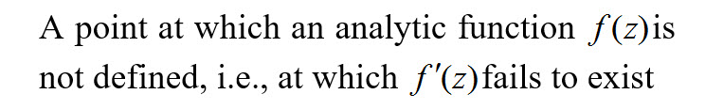
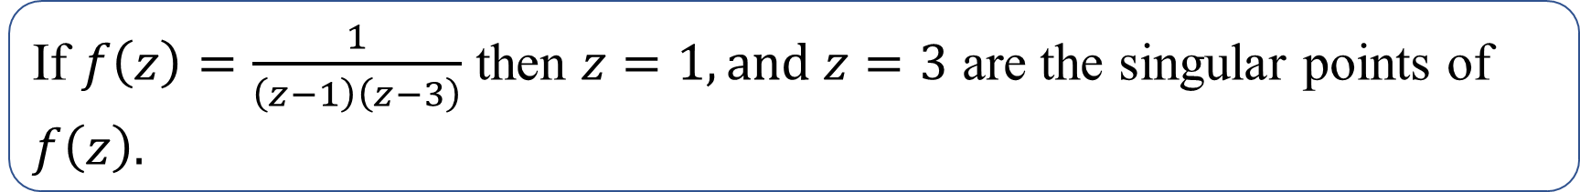
Singular point / Pole / Singularity of a function:
Example:
If $f\left(z\right)=\frac{1}{\left(z−1\right)\left(z−3\right)}$ then $z=1, and z=3$ are the singular points of $f\left(z\right).$

Slide 4

Residue Finding Method:
If $f\left(z\right)$ is analytic inside and on a simple closed curve $C\text{except} \text{at} \text{pole} \text{or} \text{has} \text{singularity} \text{at}$ $z=a of order$1, then
$$\text{Res}(z=a)=\lim_{z→a}(z−a)f\left(z\right)$$
If $f\left(z\right)$ is analytic inside and on a simple closed curve $C \text{except} \text{at} \text{pole} \text{or} \text{has} \text{singularity} \text{at}$ $z=b of order m≥1$, then
$\text{Res}(z=b)=\lim_{z→b}\frac{1}{\left(m−1)!\right.}\frac{d^{m−1}}{dz^{m−1}}\left\{\left.{\left(z−b\right)}^{m}f(z\right)\right\}$.

Slide 5
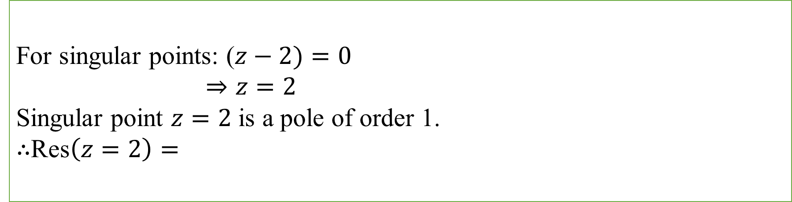
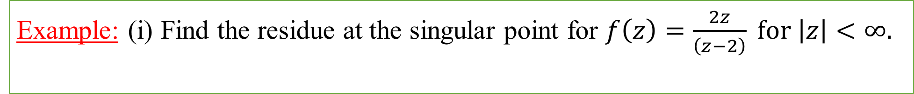
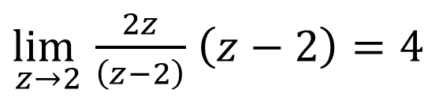
Example:
Example: (i) Find the residue at the singular point for $f\left(z\right)=\frac{2z}{\left(z−2\right)} for \left|z\right|<∞.$
Solution:
For singular points: ($z−2)=0$
$⇒z=2$
Singular point $z=2$ is a pole of order 1.
$∴$Res$\left(z=2\right)=$
$\lim_{z→2}$ $\frac{2z}{\left(z−2\right)}$ $\left(z−2\right)=4$

Slide 6

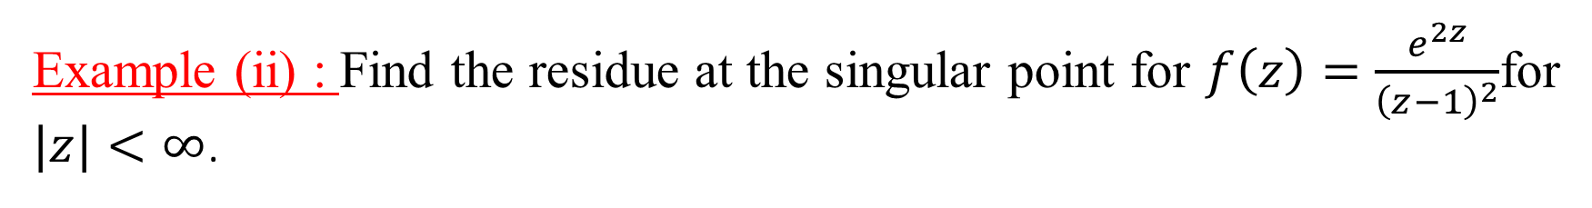

Example (ii) : Find the residue at the singular point for $f\left(z\right)=\frac{e^{2z}}{{\left(z−1\right)}^{2}}$for $|z|<∞$.
Solution: Here $z=1$ is the singular point of order 2.
$∴$Res$\left(z=1\right)= \frac{1}{\left(2−1\right)!}\frac{d}{dz}\left[\frac{e^{2z}}{{\left(z−1\right)}^{2}}{\left(z−1\right)}^{2}\right]$
= $\lim_{z→1}\frac{d}{dz}\left[e^{2z}\right]$
= $\lim_{z→1}$ $2e^{2z}$
=$2e^{2}$
$$\lim_{z→1}$$

Slide 7
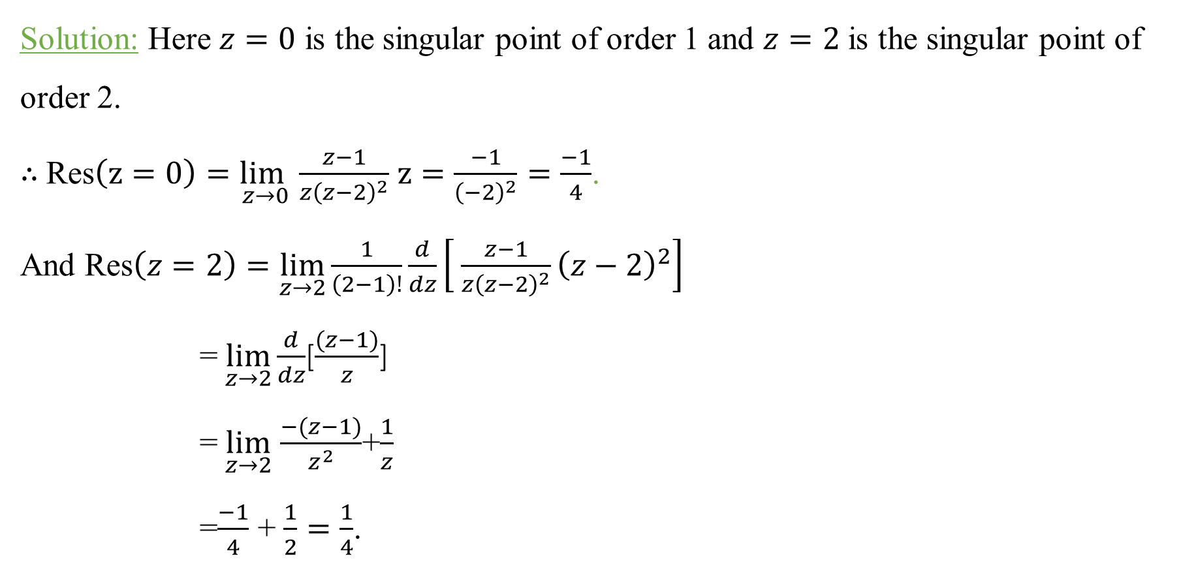
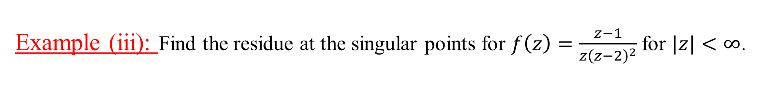
Example (iii): Find the residue at the singular points for $f\left(z\right)=\frac{z−1}{{z\left(z−2\right)}^{2}}$ for $|z|<∞$.
Solution: Here $z=0$ is the singular point of order 1 and $z=2$ is the singular point of order 2.
$∴$ Res$\left(z=0\right)=\lim_{z→0}$ $\frac{z−1}{z{\left(z−2\right)}^{2}}$ $z=\frac{−1}{{\left(−2\right)}^{2}}=\frac{−1}{4}$.
And Res$\left(z=2\right)=\lim_{z→2}\frac{1}{\left(2−1\right)!}\frac{d}{dz}\left[ \frac{z−1}{{z\left(z−2\right)}^{2}}{\left(z−2\right)}^{2}\right]$
= $\lim_{z→2}\frac{d}{dz}$[$\frac{(z−1)}{z}$]
= $\lim_{z→2}$ $\frac{−(z−1)}{z^{2}}$+$\frac{1}{z}$
=$\frac{−1}{4}$ + $\frac{1}{2}=\frac{1}{4}$.

Slide 8
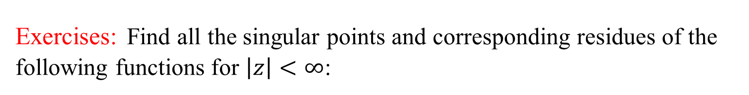
Exercises: Find all the singular points and corresponding residues of the following functions for $\left|z\right|<∞$:
$∗∗∗ f\left(z\right)=\frac{1}{z}, \frac{1}{z^{2}−1},\frac{sinz}{z}$ , $\frac{z^{2}+1}{z^{2}+z}$ ,$\frac{z+2}{\begin{aligned}z(z+1) \\ \end{aligned}},\frac{2z}{{\left(2z−i\right)}^{3}}$, $\frac{2z−1}{z^{2}−z}$

Slide 9
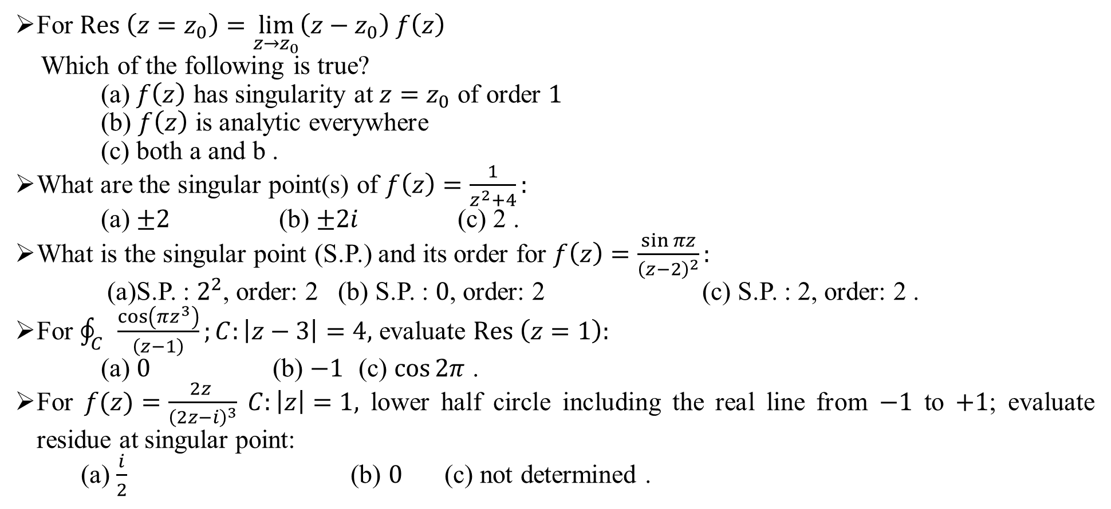
Sample MCQ:
For $Res \left(z=z_{0}\right)=\lim_{z→z_{0}}\left(z−z_{0}\right) f\left(z\right)$
Which of the following is true?
(a) $f\left(z\right)$ has singularity at $z=z_{0}$ of order $1$
(b) $f\left(z\right)$ is analytic everywhere
(c) both a and b .
What are the singular point(s) of $f\left(z\right)=\frac{1}{z^{2}+4}:$
(a) $±2$ (b) $±2i$ (c) 2 .
What is the singular point (S.P.) and its order for $f\left(z\right)=\frac{\sin{πz}}{{\left(z−2\right)}^{2}}:$
(a)S.P. : $2^{2}$, order: 2 (b) S.P. : $0$, order: 2 (c) S.P. : 2, order: 2 .
For $\oint_{C}{\frac{\cos\left(πz^{3}\right)}{\left(z−1\right)}};C:\left|z−3\right|=4,$ evaluate $Res \left(z=1\right):$
(a) $0$ (b) $−1$ (c) $\cos{2π}$ .
For $f(z)=\frac{2z }{{\left(2z−i\right)}^{3}} C:\left|z\right|=1,$ lower half circle including the real line from $−1$ to $+1$; evaluate residue at singular point:
(a) $\frac{i}{2}$ (b) $0$ (c) not determined .

